Slide 1

Spring boot project
Aditya Muley Emp_ID : 206016

Slide 2
Installation of Spring boot and dependencies
Open url : https://start.spring.io/
Select maven in project and java as language
Spring boot version – 3.3.2(default version)
Packaging as jar and version – 17
Goto Dependencies → Click on add dependencies → Search for Spring Web, Thymeleaf
Click on generate, it will download the file

Slide 3
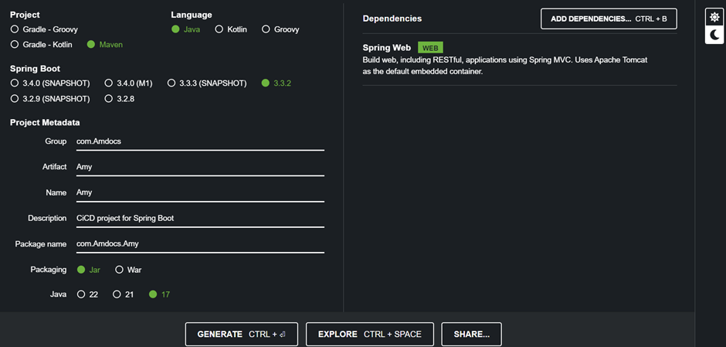

Slide 4
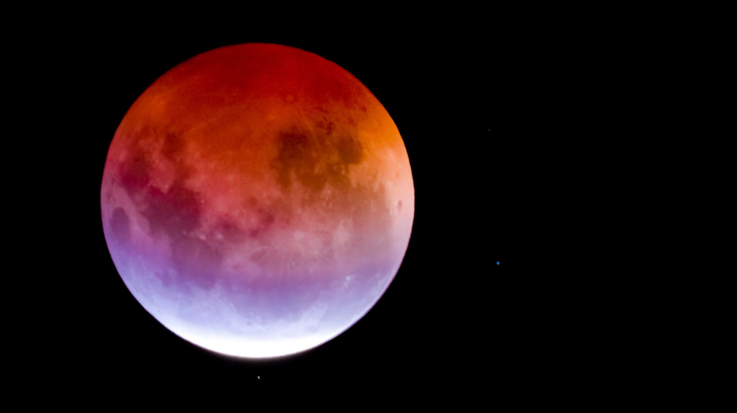
Eclipse
Download Eclipse software from official eclipse website or
Open url : https://www.eclipse.org/downloads/
Download the Software
Similarly, download java-jdk, and add the path in environmental variables.

Slide 5
Open your eclipse desktop
Click on File →Import →Maven → Existing Maven Projects →Next →From Browse select your downloaded maven spring boot file →Finish
This will open a demo file in your eclipse desktop
Demo →Src/main/java → Com.Amdocs.Amy →Amy.java
Write Your project code.
Download Jenkins
Type localhost:8084
Using your username and password login in you Jenkins account.

Slide 6
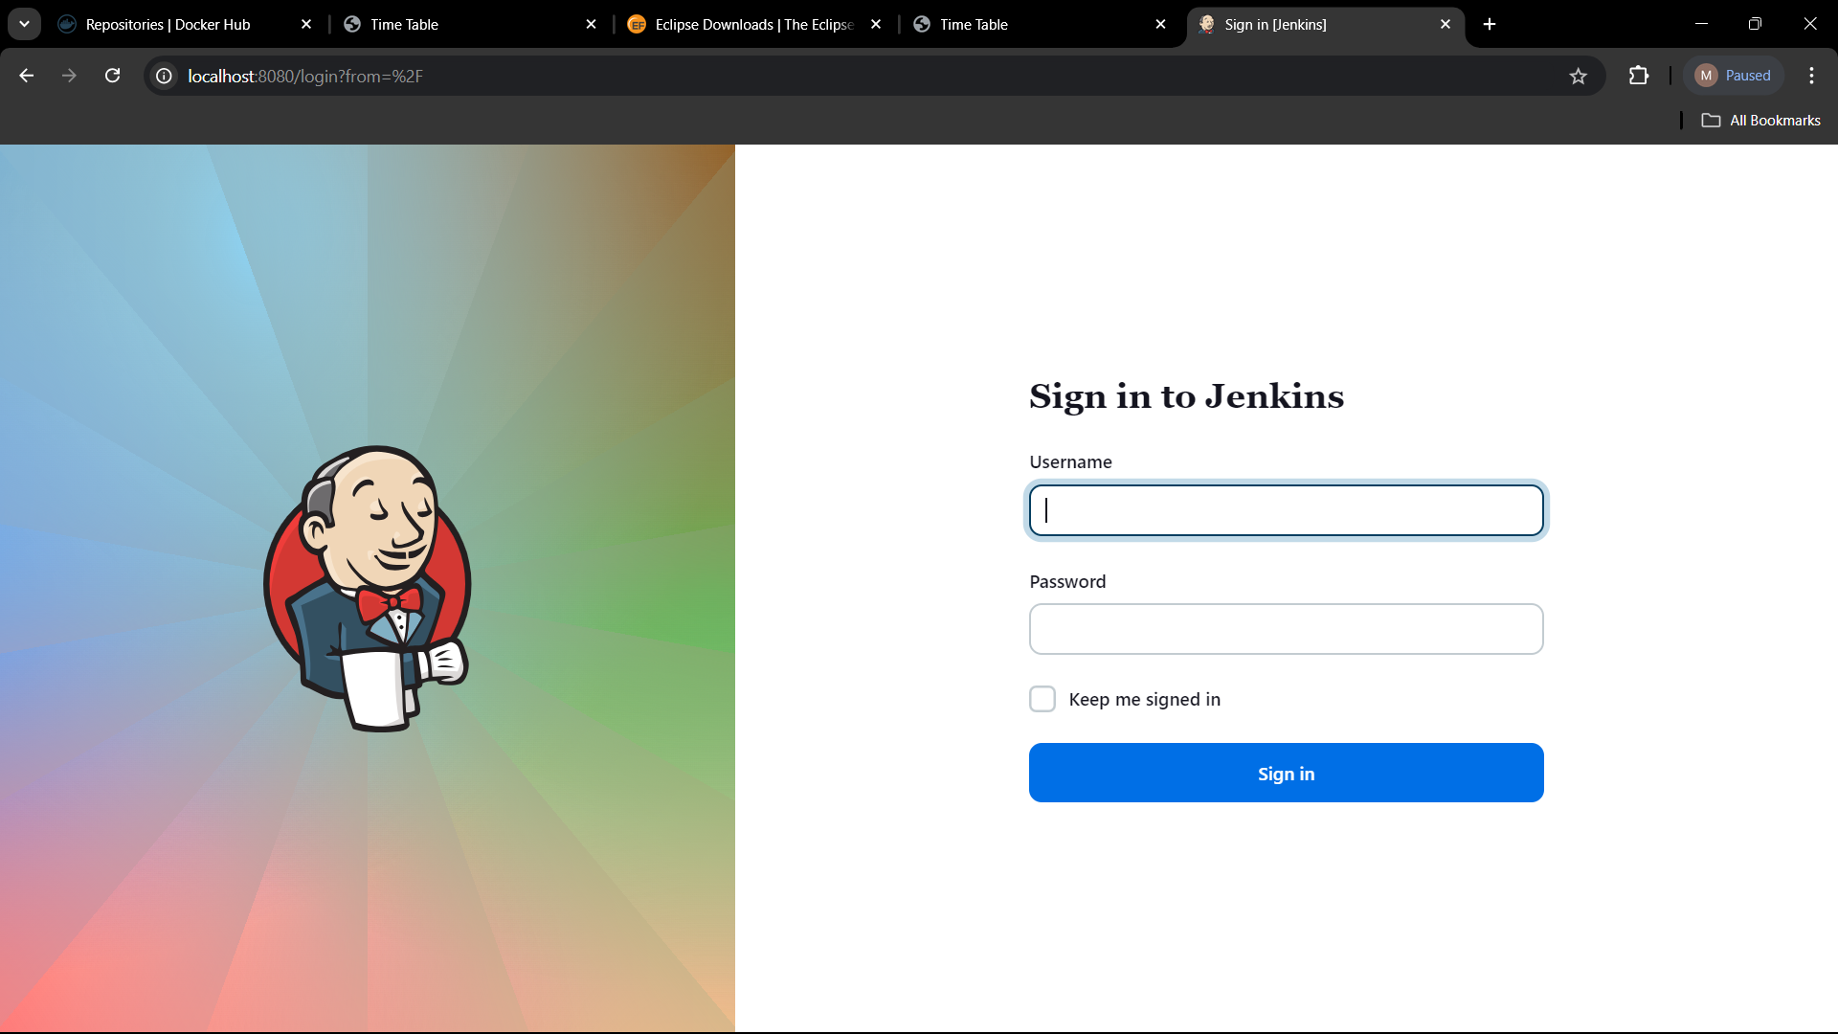

Slide 7
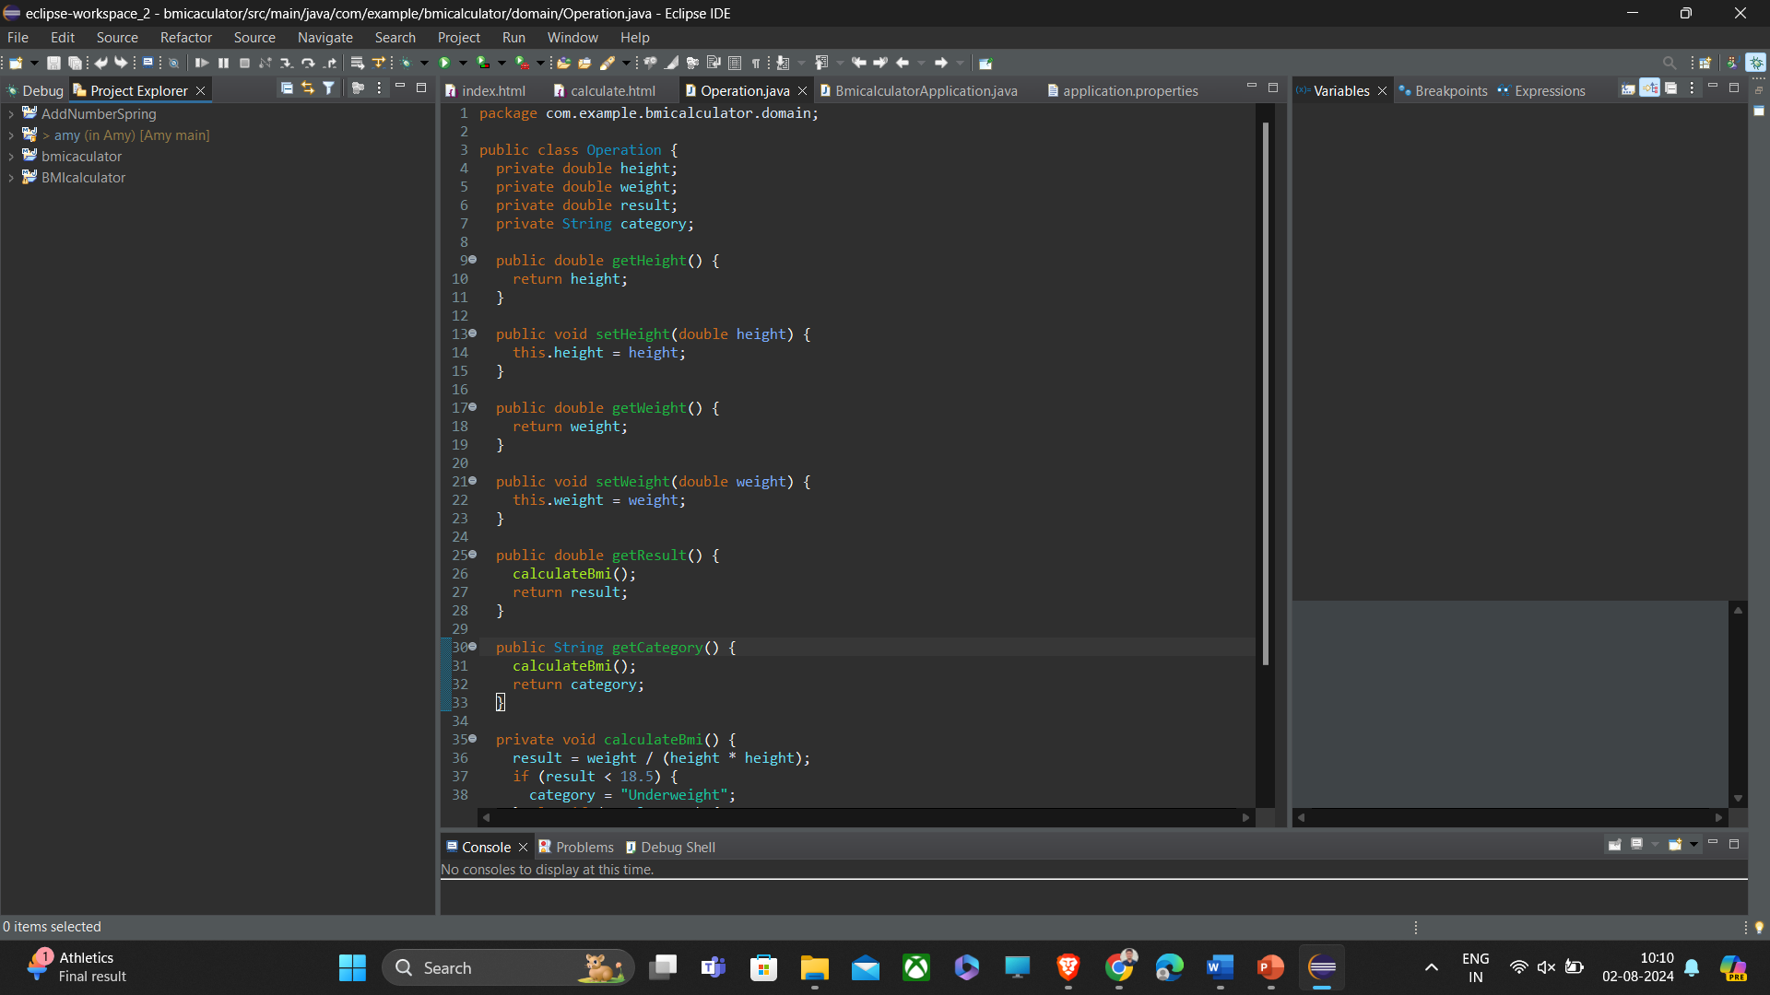

Slide 8
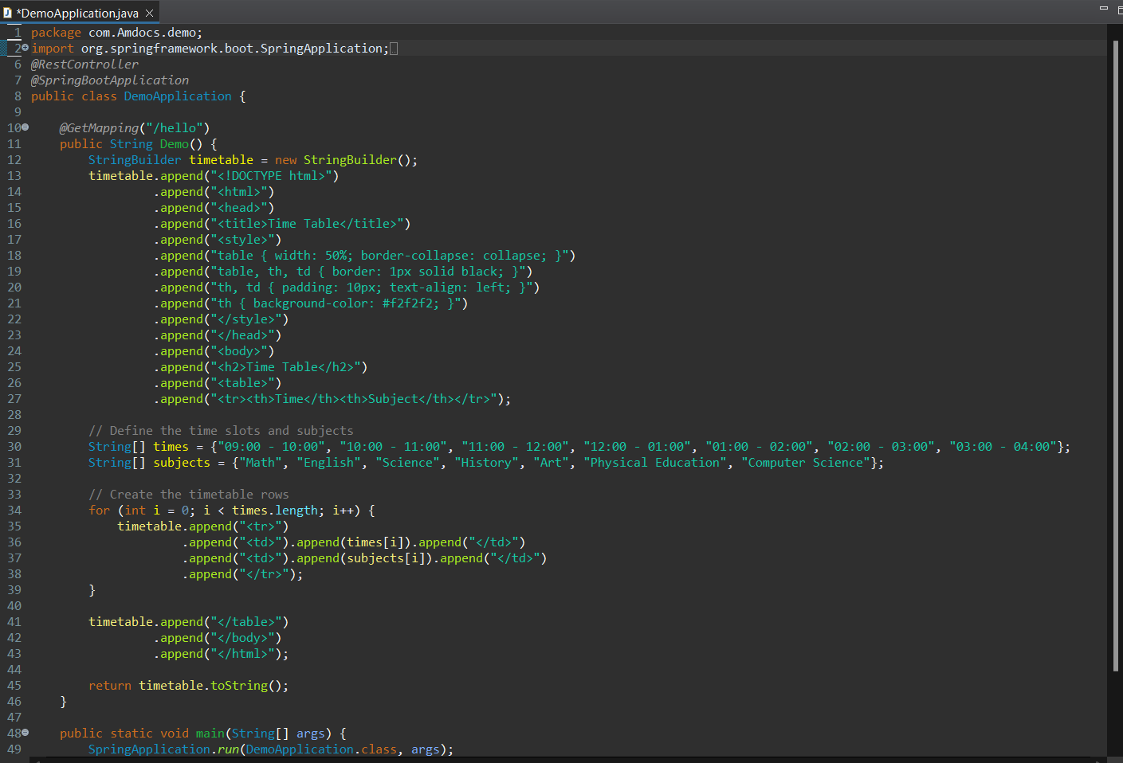
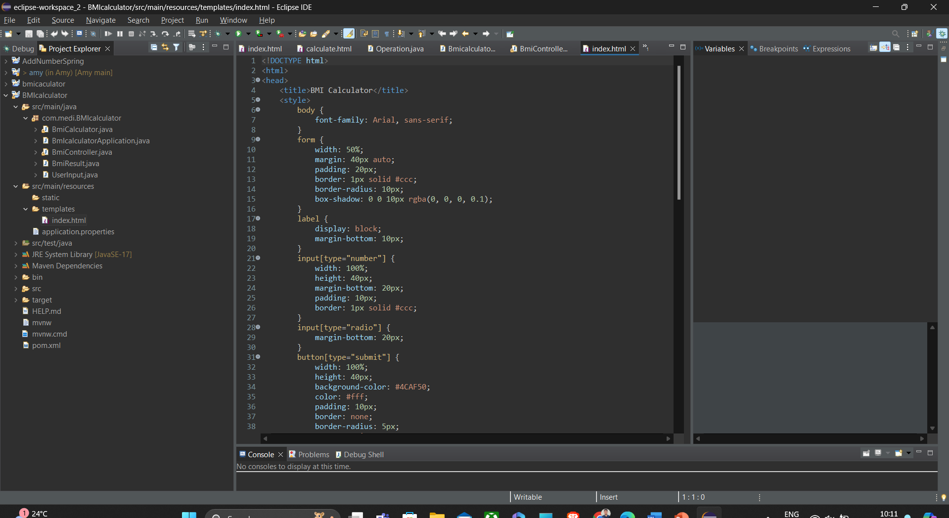

Slide 9
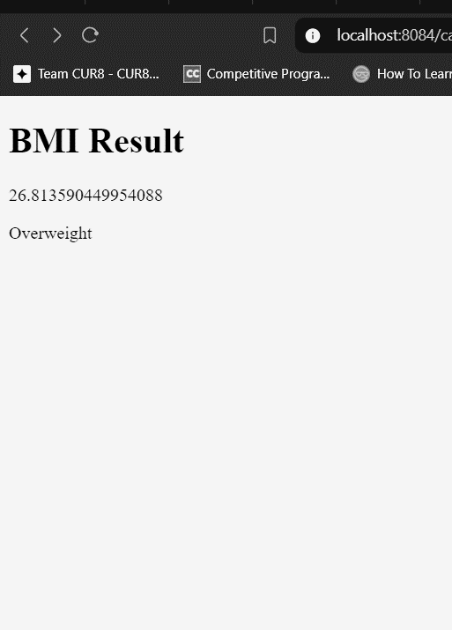
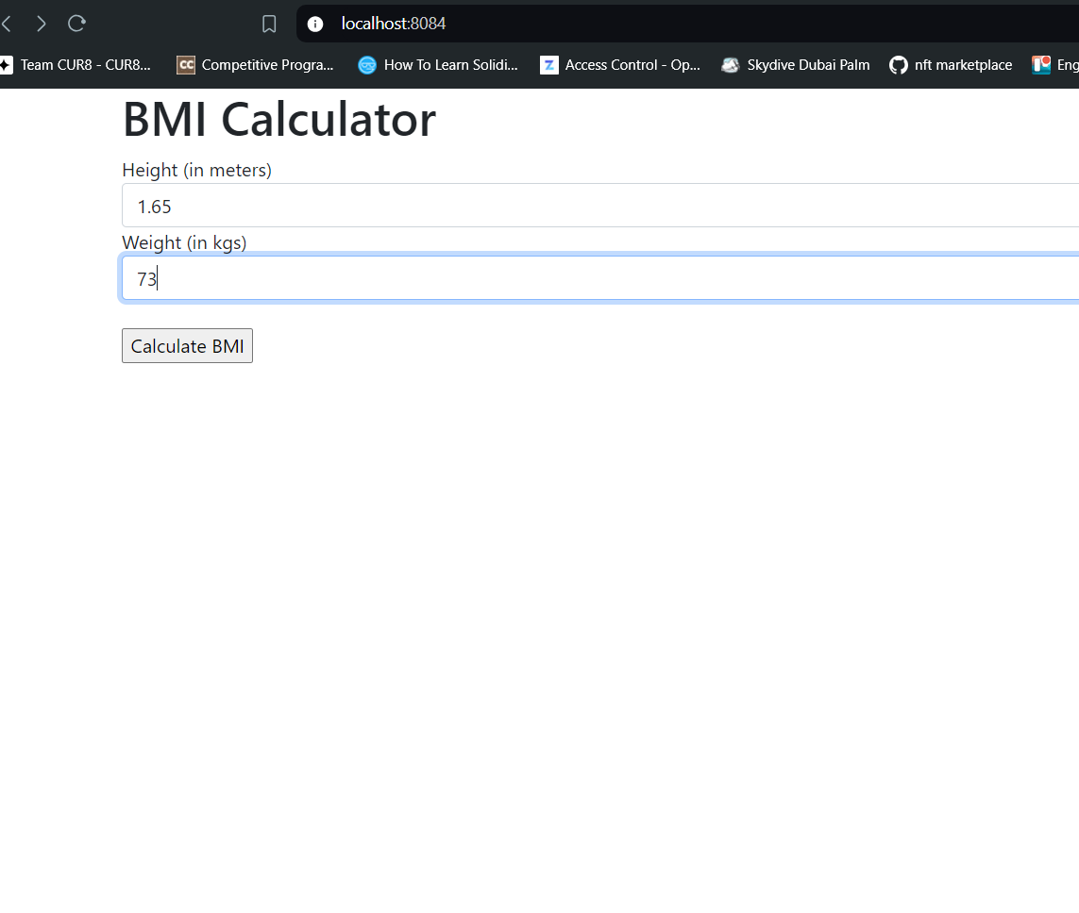

Slide 10
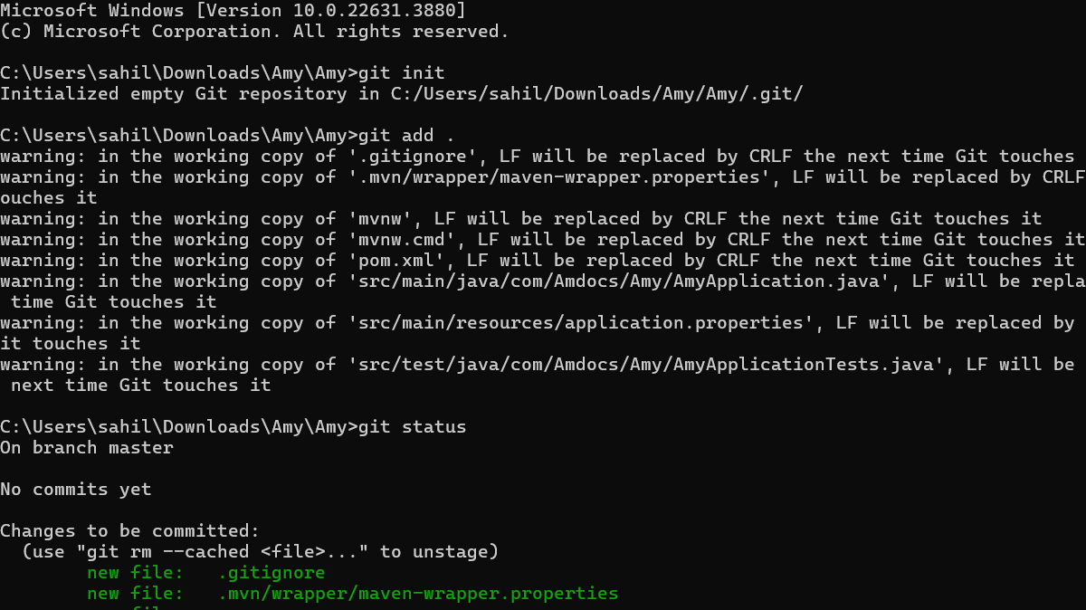
Github push
Using Command prompt push the project in the created repository
Follow the following commands for pushing in github

Slide 11

Jenkins
After successful push in Github.
Goto Jenkins.
New item →Enter an item name →Free style project →ok
It will create a new item in Jenkins
Complete the buildup steps in Jenkins
Click on build now

Slide 12
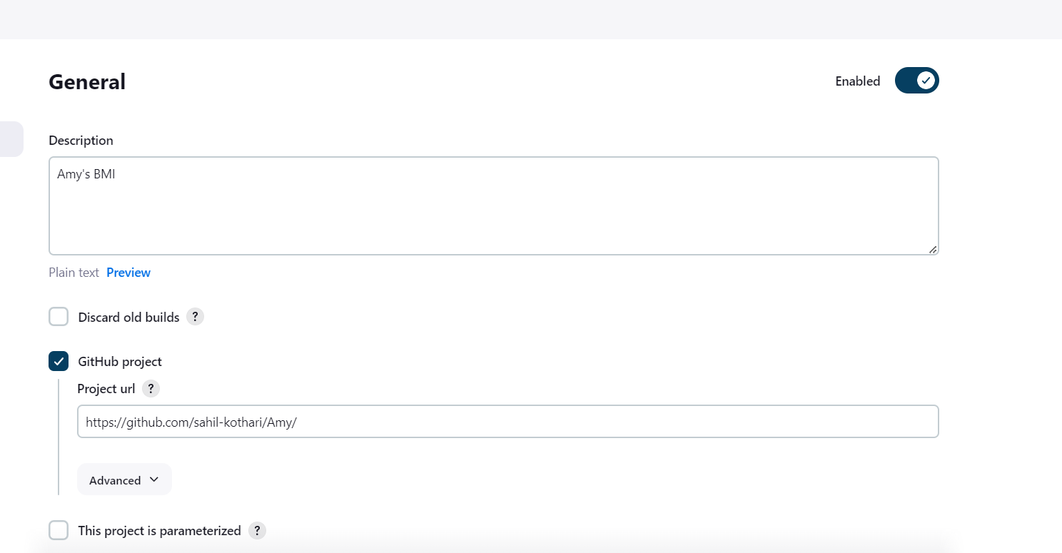
Setting Up Jenkins

Slide 13
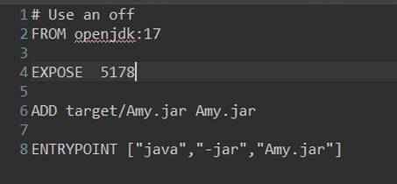
Docker push
Install Docker desktop and sign in to your account.
Create a new repository in docker desktop.
Go to eclipse →New →File →give file name as “Dockerfile”.
Go to Dockerfile and give the following commands

Slide 14

Run the Dockerfile
Goto project and click it and run as Maven install
Goto cmd and follow the below commands
Docker build –t TITLE
Docker run –p PORT:PORT TITLE
Again open the cmd.
The below commands in cmd push the project in docker
Docker tag TITLE Reponame
Docker tag amy:latest usname/amy:latest
Docker push usname/amy:latest
Docker pull userid/docky_amy:latest
Above commands will push the project in docker

Slide 15
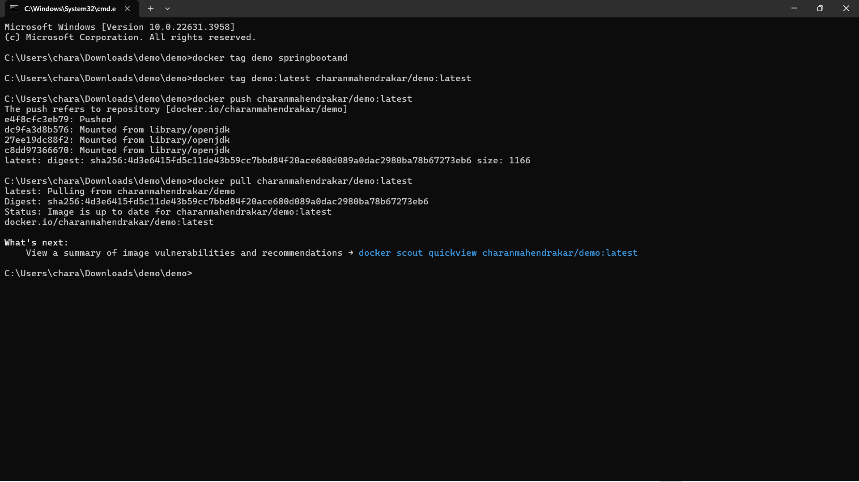

Slide 16
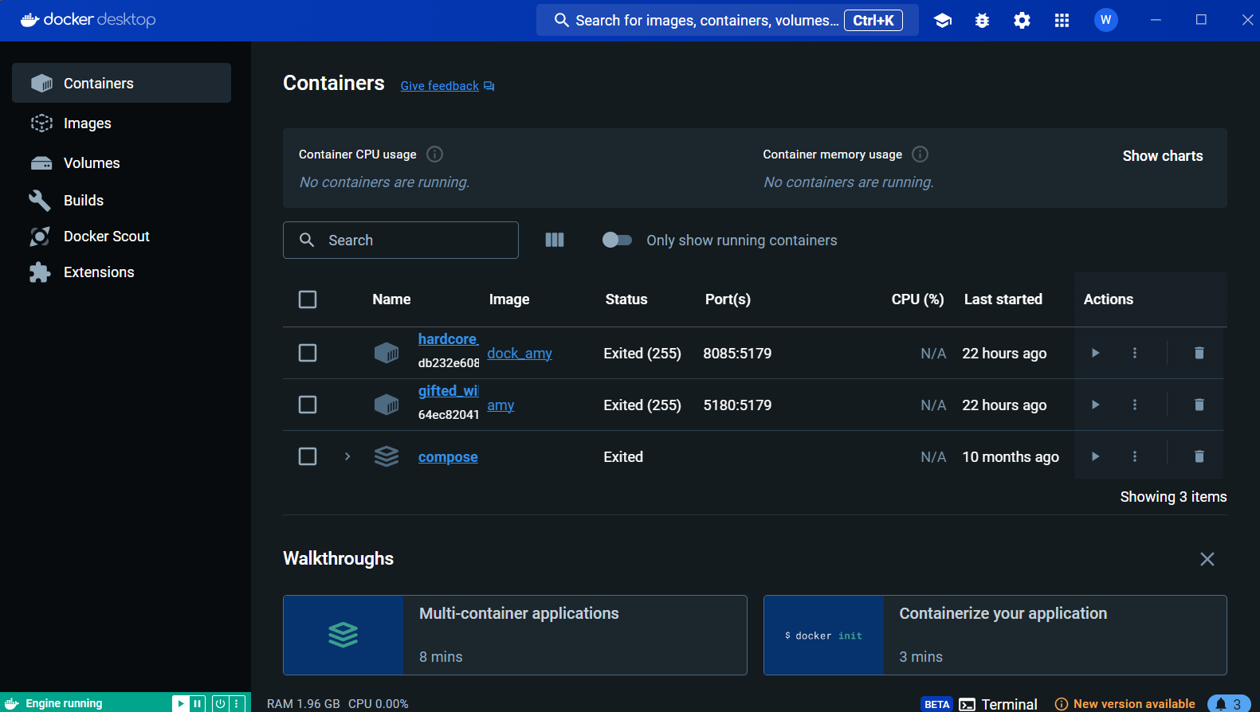

Slide 17

Thank You

